Slide 1
Plumbing H&S Hazard Slides + Practical Task

Slide 2
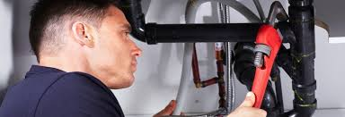
Eye injury
Plumbers face the possibility of an eye injury every day. Flying particles, sparks, chemicals, falling objects, the chance of a pipe bursting or even water (which seems innocent enough until it jets into your eye). Having proper, protective eye wear on every job, no matter if you anticipate debris or not, is essential.

Slide 3
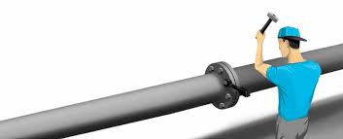
Too much noise/hearing loss
The layman may be shocked by how loud plumbing can be, but your average plumber certainly would not be. According to The World Health Organization’s Protection of the Human Environment report from 2004, 48 percent of plumbers reported they have experienced a perceived hearing loss.
Loud electronic machinery, banging tools and your occasional extremely noisy pipes will all add up. For many plumbers, this can unfortunately spell hearing loss.
It may be a great idea to bring ear plugs to certain jobs. After all, we protect our eyes… why not take care of our ears too?

Slide 4
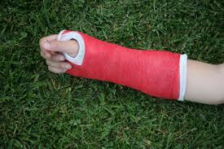
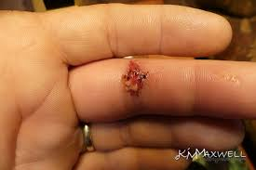
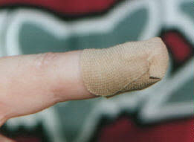
Hand tool injuries
Hand tools are used frequently by plumbers.
Wrenches and spanners need to be the correct size/gauge. If you slip whist tightening or loosening a fitting not only will you ‘round’ the head of a nut on a fitment, you may also bruise, scrape or even cut your knuckles.
Different types of hammers are used in all trades. A misjudged swing of the hammer may injure you and expensive items (a basic pedestal cloakroom basin cost around £69).

Slide 5
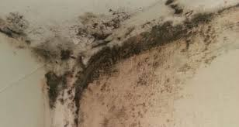
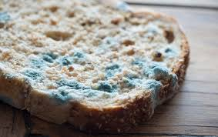
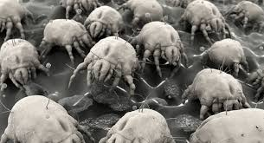
Mould
Mould can be found in bathrooms, panelling, under sinks and any area where a plumber may work. If you don’t see it but you breathe it in, you may notice itchy eyes, coughing and sneezing. In a worst case scenario, there can be severe reactions to mould, such as fever and difficulty breathing.
If you see mould when on a job, let the homeowner know and be sure to take any precautions for guarding your airways before continuing work. Wear protective gloves, goggles and long sleeves to help keep the mould off your skin and be sure the area is well-ventilated

Slide 6
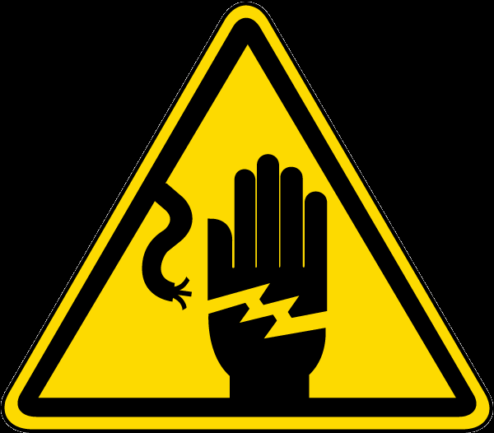
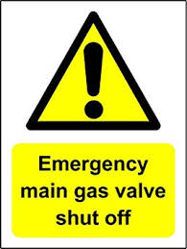
Flammable and electric situations
There are plenty of moving pieces attached to plumbing, and some of those pieces happen to be attached to electricity and gas.
The proper protective gear is necessary.
Be sure gas lines and power are shut off when they need to be, gloves are on and caution is used whenever you encounter flammable or electric situations.

Slide 7
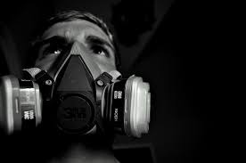
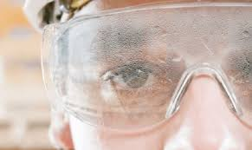
Exposure to nasty materials
Potential infection from rodent droppings, working with human waste, exposure to biohazard materials and exposure to other biohazard materials are all risks of the job.
The keys here are safety, precautions and plenty of cleaning. Plumbers should have gloves, goggles, respiratory masks and wear long sleeves when working with hazardous materials of any kinds. Thorough showers and washing should happen after working with these materials.
Plumbers must be honest with themselves before every job as to whether there is a potential danger for dealing with materials that could make them sick. Extra precaution needs to be taken whenever there is even a slight chance of toxicity.

Slide 8
Practical Task –
Demonstration by your SATRO tutor
Cut copper using a pipe cutter to a length of 100mm
Deburr pipe ready for soldering using the tools
supplied by your tutor
Questions
Why do you think it is important to deburr a pipe?
How would you carry out this operation safely?

